Slide 1
Masters Analysis
The state of master degrees offered around the world
Marcos Jurach

Slide 2
The starting point and the goal
Data scrapped from a single website
Over 60k entries
Bigger picture and case study

Slide 3
Looking at its own definition
The definition of a master is wide
These are courses offered in English for everyone interested
No matching titles on the analysis

Slide 4
Case study
Is the price of a course predictable?
Price vs formation type
Price as a categorical variable

Slide 5
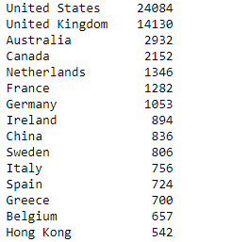
Courses by country
United States and United Kingdom dominates the list
If we count China and Hong Kong as a same source, they would be in 5th
The top 15 countries offer up to 87% of the total amount of courses

Slide 6
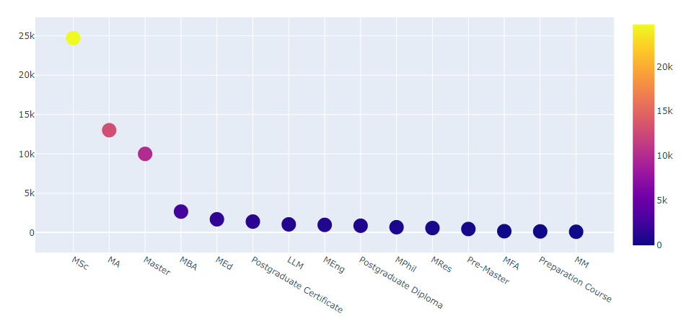
Program type
Master, in general, is the 3rd most offered formation
The amount of MPhil courses, compared to MSc and MA, is really low

Slide 7
Can we predict the program price?
Analysis of the US programs
Price divided by classes
4 classes total, based on the quantiles
Features related to the applicant
Program types
IELTS score

Slide 8
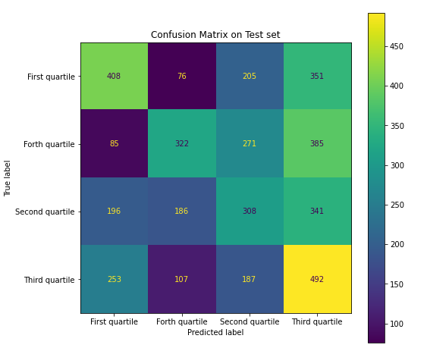
Can we predict the program price?
The best model was the Random Forest
The score was 0.369
Prices between the 2nd and 3rd quartile are hard to predict
Strangely enough, the model wrongfully guesses prices on the highest range more frequently for the values that are on the 2nd range than the 3^{rd.}

